Slide 1
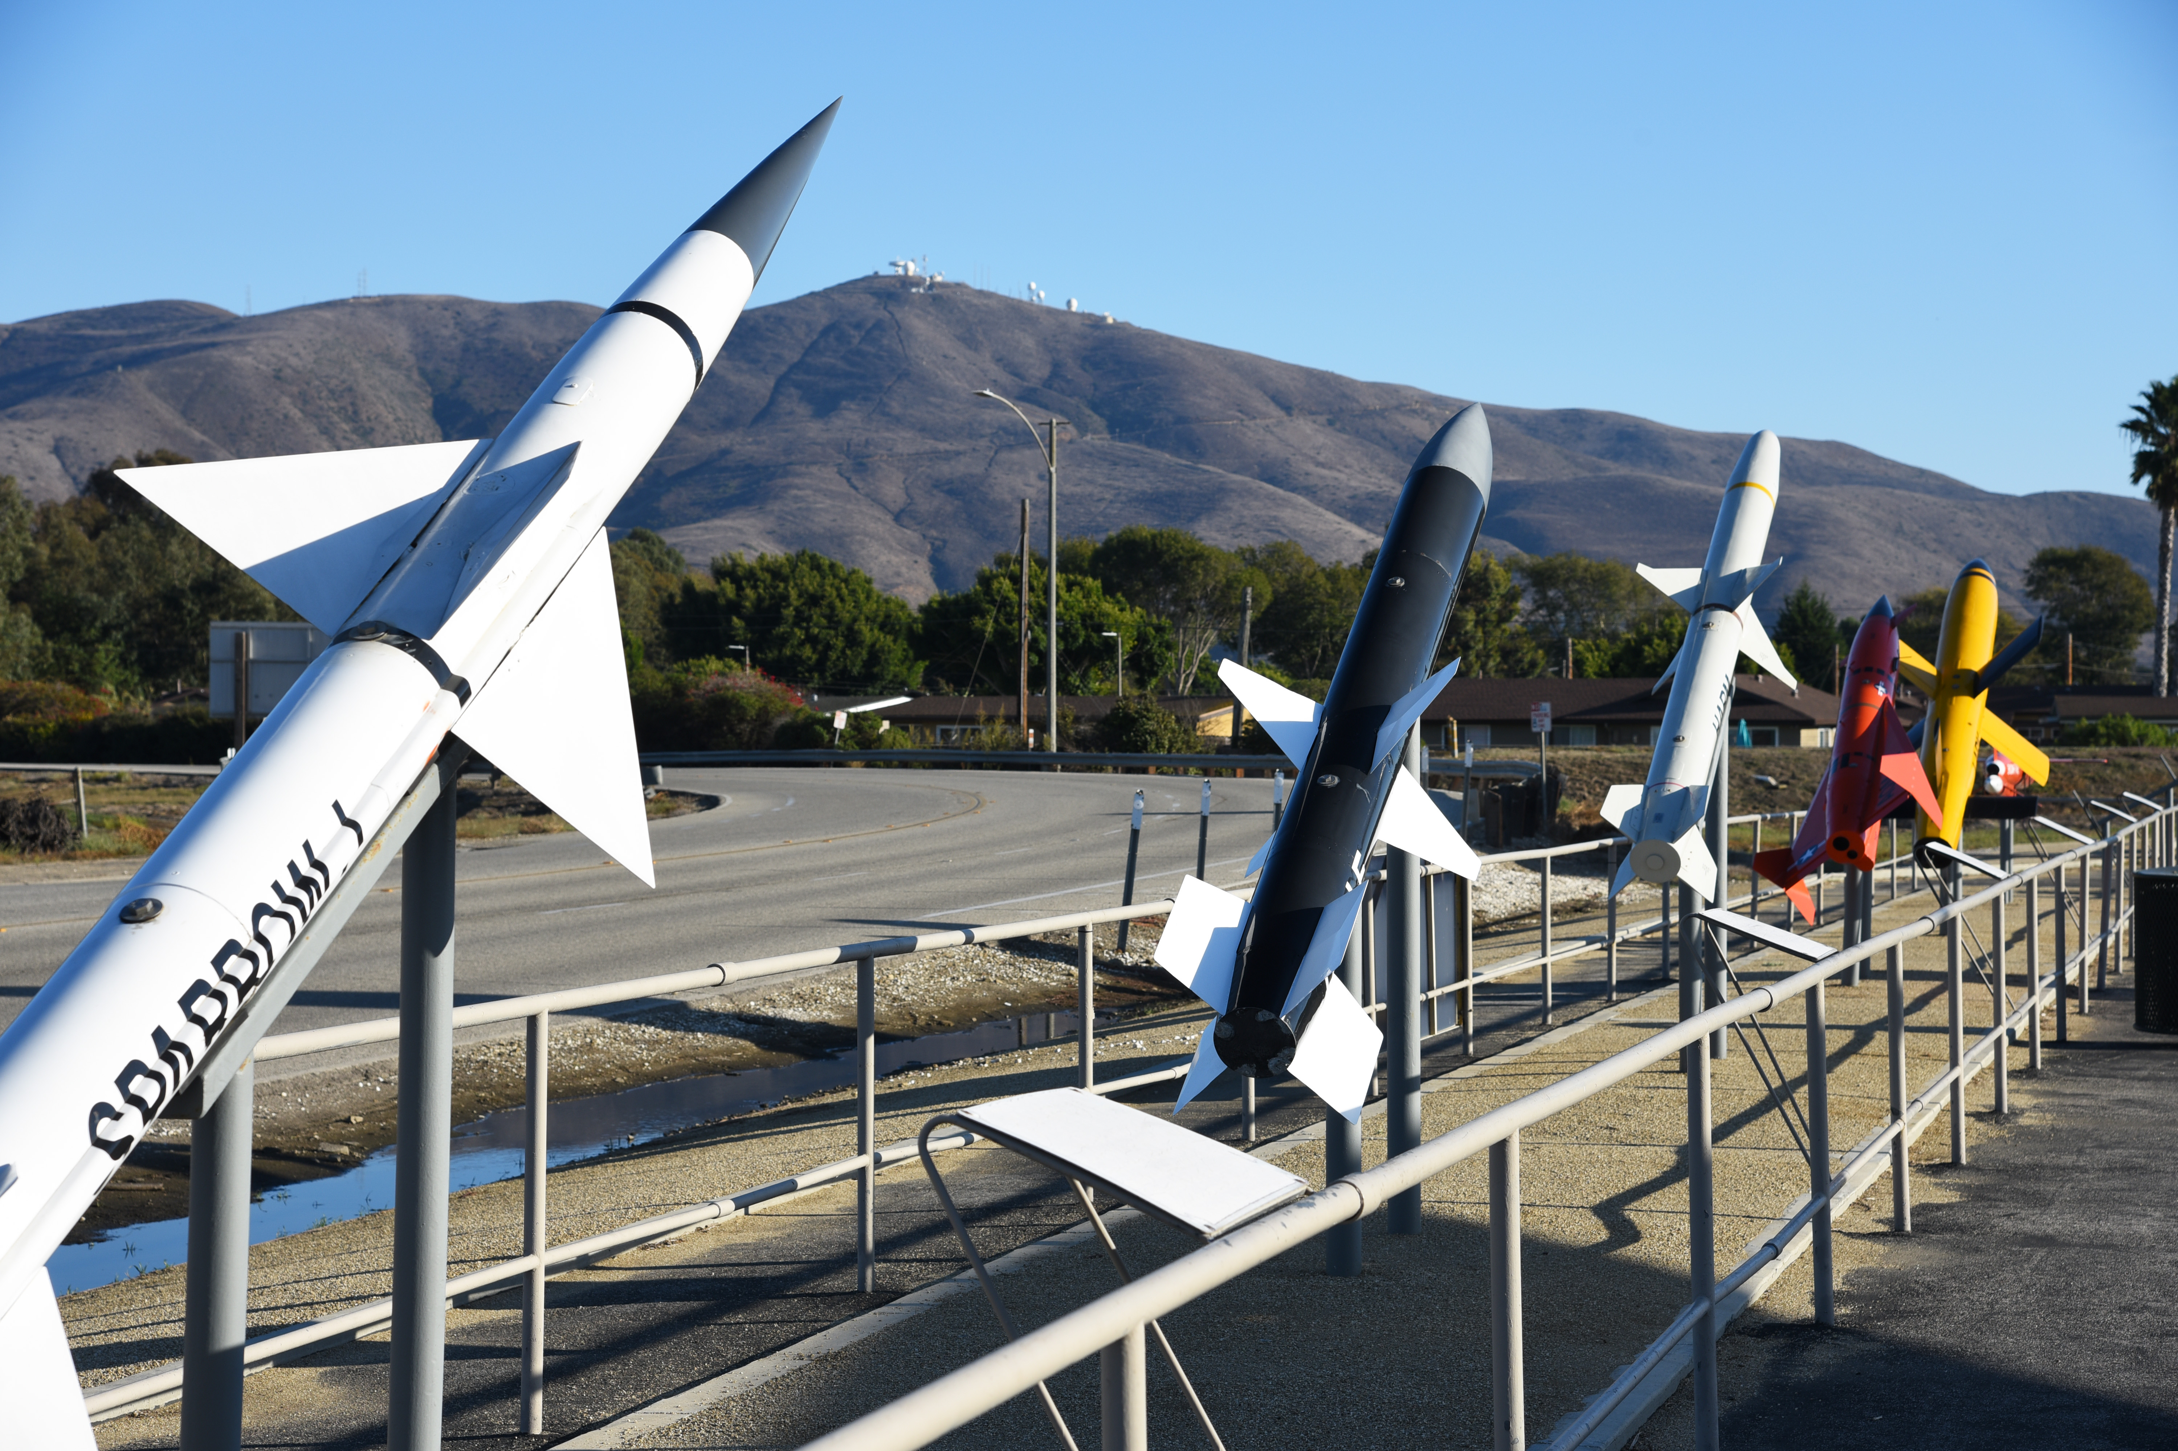
Articulating Nose Cone
Jed Fazler | Noah Moffeit | Nicholas Samuda | Robert Smith
Notes:
https://visualhunt.com/f7/photo/32891036558/2ed24545c0/

Slide 2



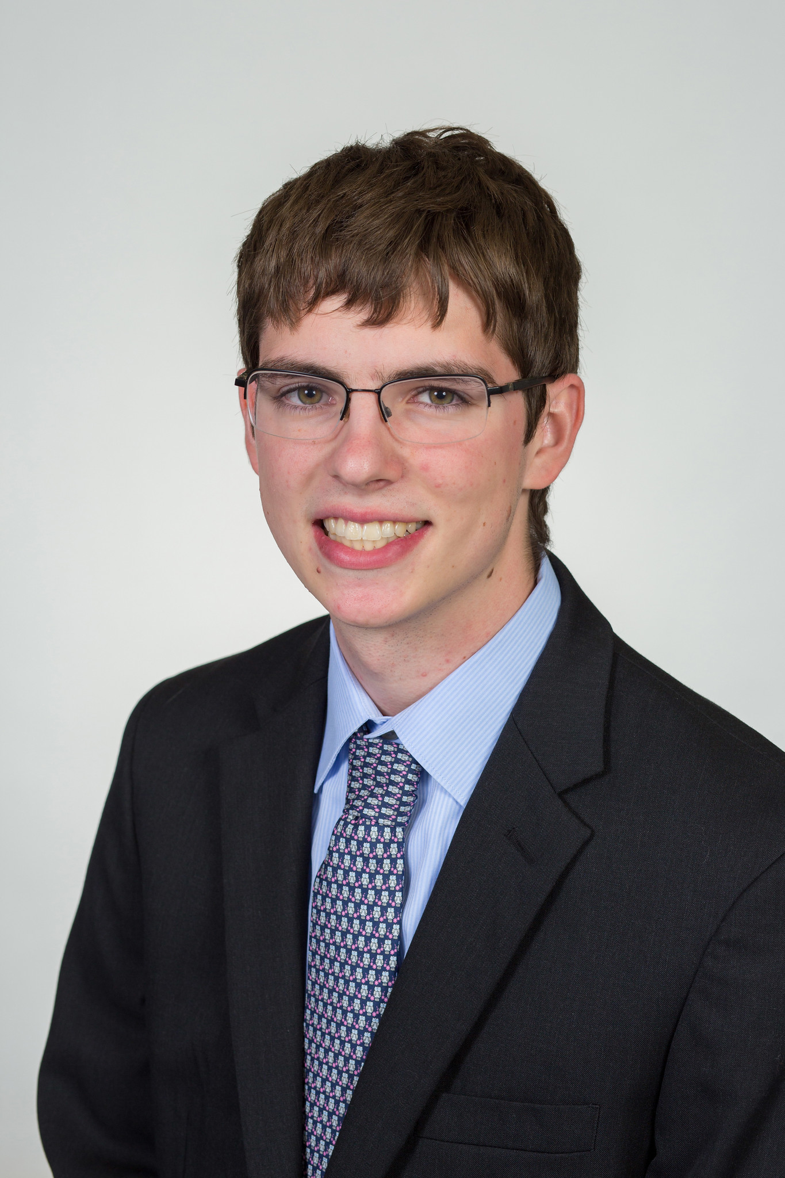
Team 504 Introductions
Jed Fazler
Field Engineer
Noah Moffeit
Design Engineer
Nicholas Samuda
Systems Engineer
Robert Smith
Research Engineer
Jed Fazler

Slide 3
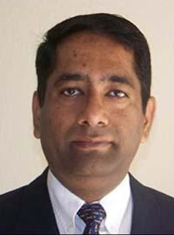
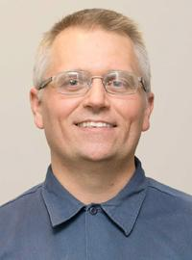

Sponsor and Advisor
Dr. Rajan Kumar
Dr. Jonas Gustavsson
Jed Fazler
Notes:
Our project sponsor is Dr. Rajan Kumar, he is an Associate Professor at the FAMU-FSU college of engineering and the Director of the Florida Center for Advanced Aero-Propulsion. Our project advisor is Dr. Jonas Gustavsson who works as an Associate Scientist at FCAAP.

Slide 4
Project Objective
The objective of this project is to create a method of articulation for a nose cone on a missile model while keeping a smooth edge transition.
Jed Fazler

Slide 5
Project Background
AFRL wants to investigate alternatives for fin deflection
Studies show nose deflection as a viable method for control
FCAAP is brought on to further study the effects of a deflecting nose
Articulating Nose Cone project begins
Jed Fazler

Slide 6
Project Considerations – Tunnel Testing
  Can adjust nose position rapidly for tests
  Small enough to avoid blockage in the tunnel
  Implemented with available data acquisition systems
Jed Fazler

Slide 7
Project Considerations – Real World
Design must be scalable
Allows for varying pitching speeds
Jed Fazler

Slide 8
Assumptions
The ANC has access to power from outside of the wind tunnel
The ANC can use the available arc sector for mounting
Wind tunnel control systems are already in place for testing
Nicholas Samuda

Slide 9
Critical Targets and Metrics
Articulate the nose cone to obtain a pitch and yaw of ± 20°
Keep transition edges smooth between nose and body
θ
Nicholas Samuda

Slide 10
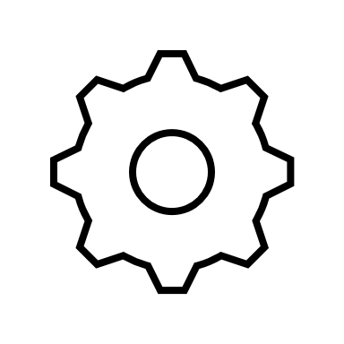
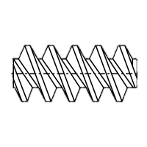
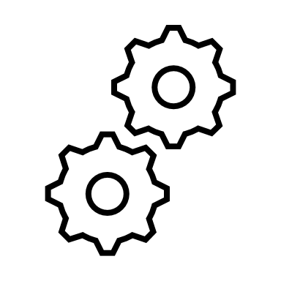

Concept Generation
Nose Pulleys
Linear Actuators
Concentric Surfaces
2 DOF Gear Box
Pin Slot Deflector
Belt Driven Nose
Nicholas Samuda

Slide 11
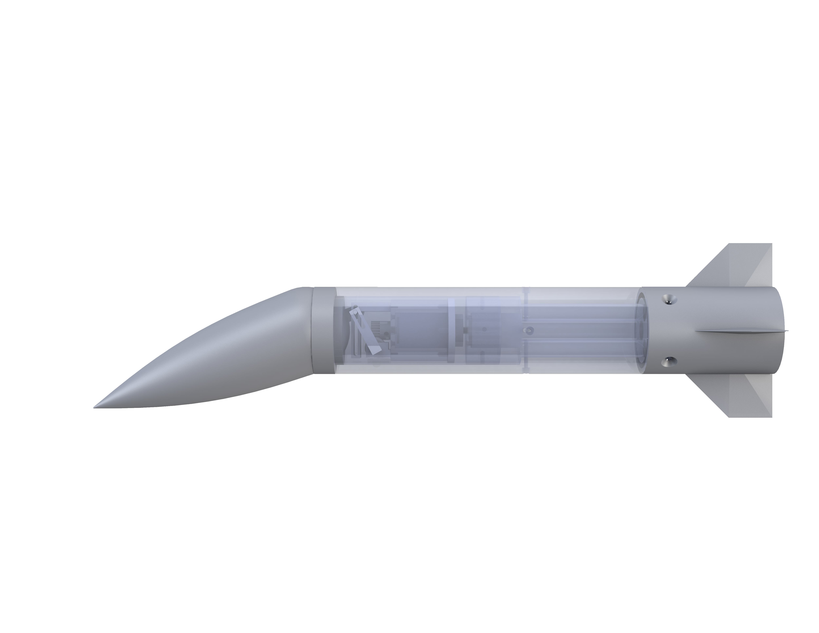
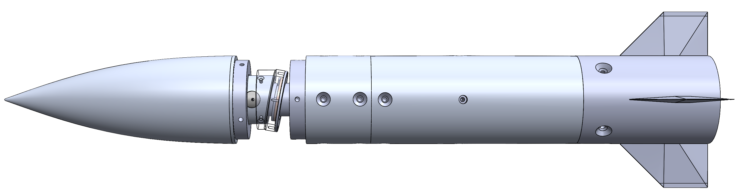
High Fidelity Concepts
Pin Slot Deflector
Concentric Surface
Nicholas Samuda

Slide 12
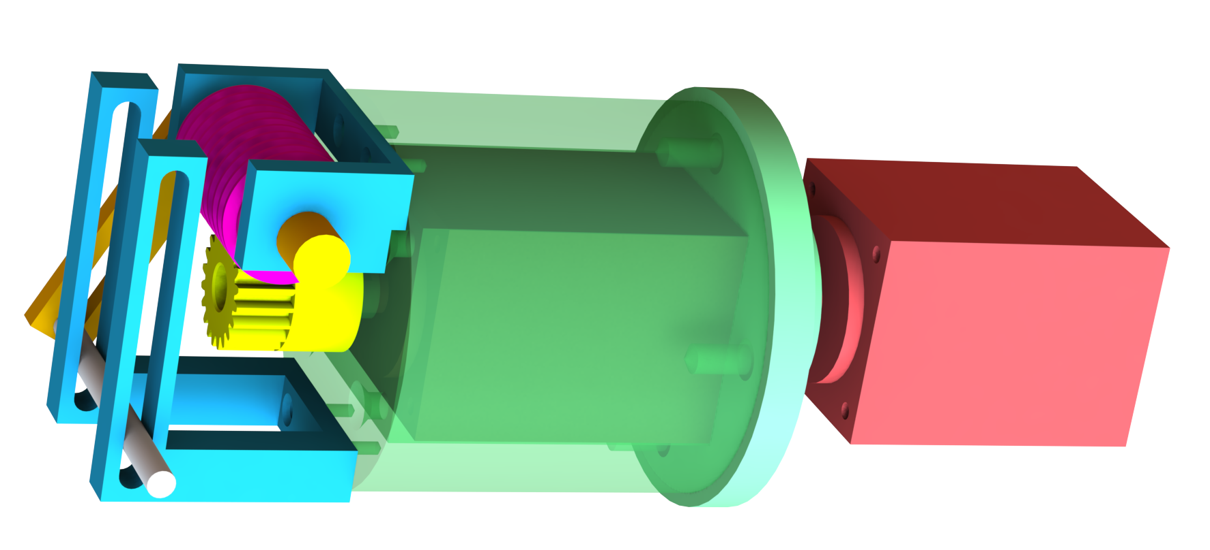
Pin Slot Deflector
Transforms motion using a worm gear
Drives nose deflection with a pin slot
Rotates nose with a second stepper motor
Nicholas Samuda

Slide 13
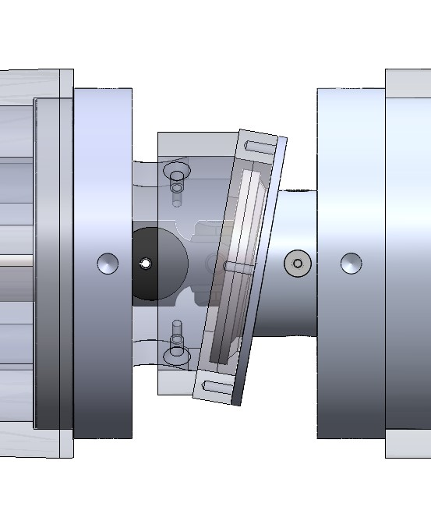
Concentric Surfaces
Implements the use of two angled surfaces for articulation
Uses two stepper motors for rotation and deflection
Translates power through a universal joint
Nicholas Samuda

Slide 14


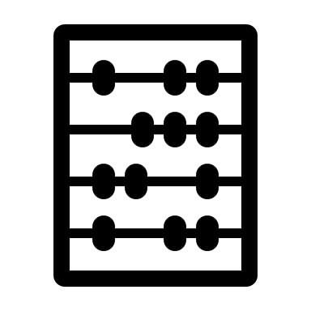
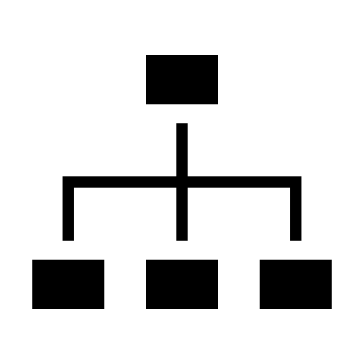
Concept Selection
Pairwise Comparison
House of Quality
Pugh Chart
Analytical Hierarchy Chart
Nicholas Samuda

Slide 15
Selected Design – Concentric Surfaces
Nicholas Samuda

Slide 16
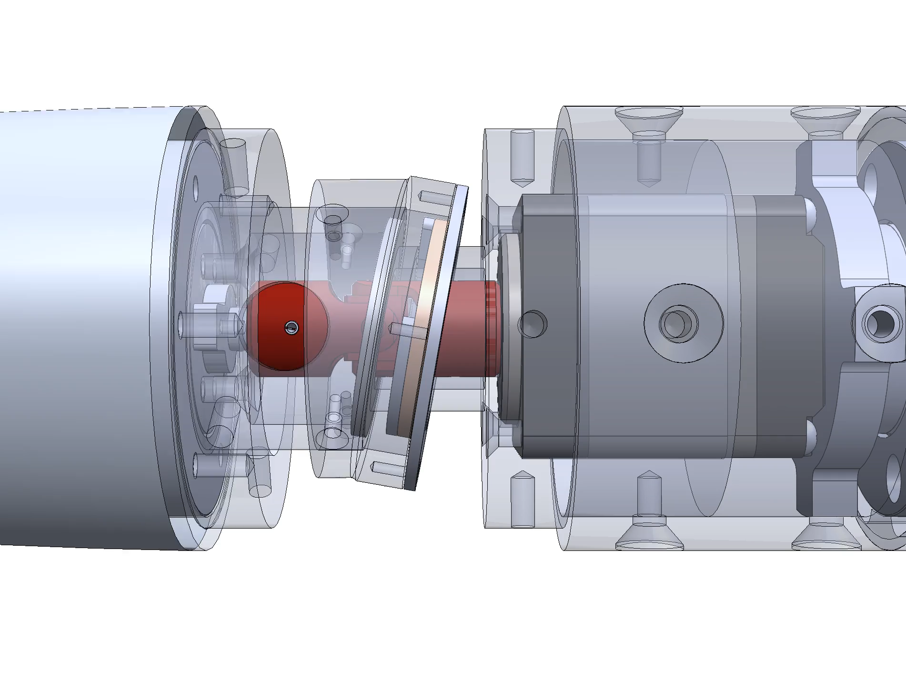
Contact Surface Operation
Universal joint highlighted in red
  Allows for power translation
Custom collar designed to prevent axial translation
Noah Moffeit

Slide 17
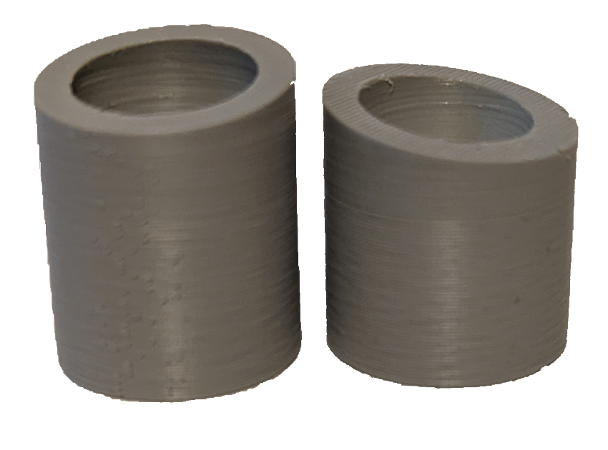
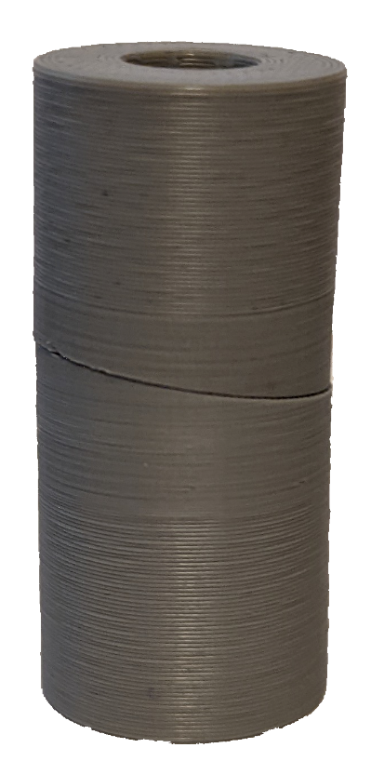
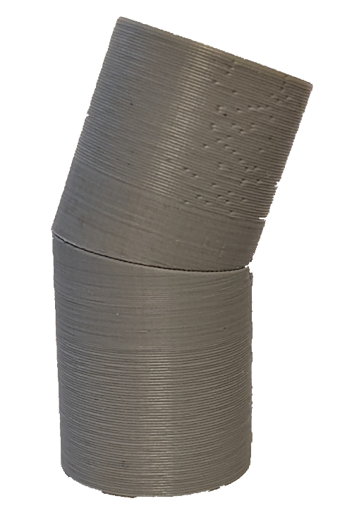

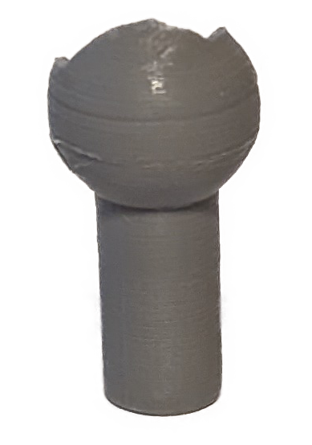
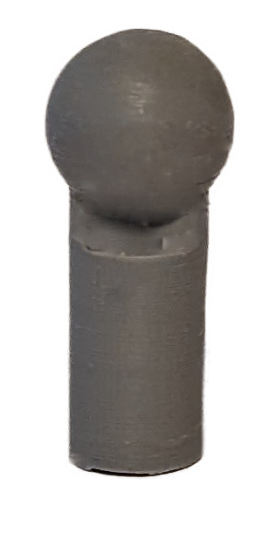

Concentric Surface Prototyping
20° of rotation achieved
10° concentric surfaces
Universal joint
Ball and socket pins
Noah Moffeit

Slide 18
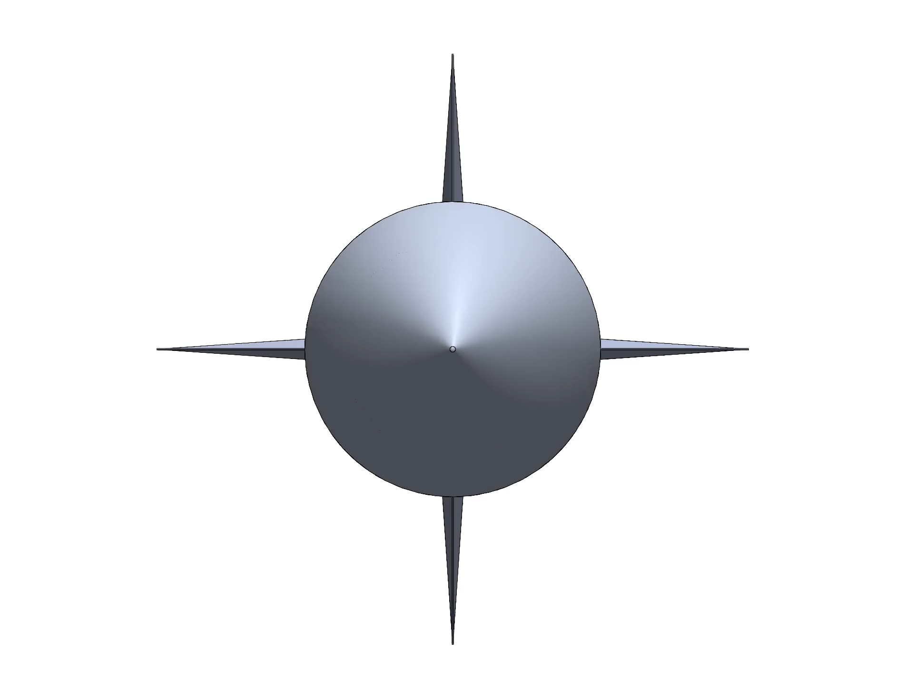
Nose Deflection Process
Operation allows for 20° of deflection
The deflection is then directed into the desired position
  Working towards rotating and deflecting in unison
Noah Moffeit

Slide 19
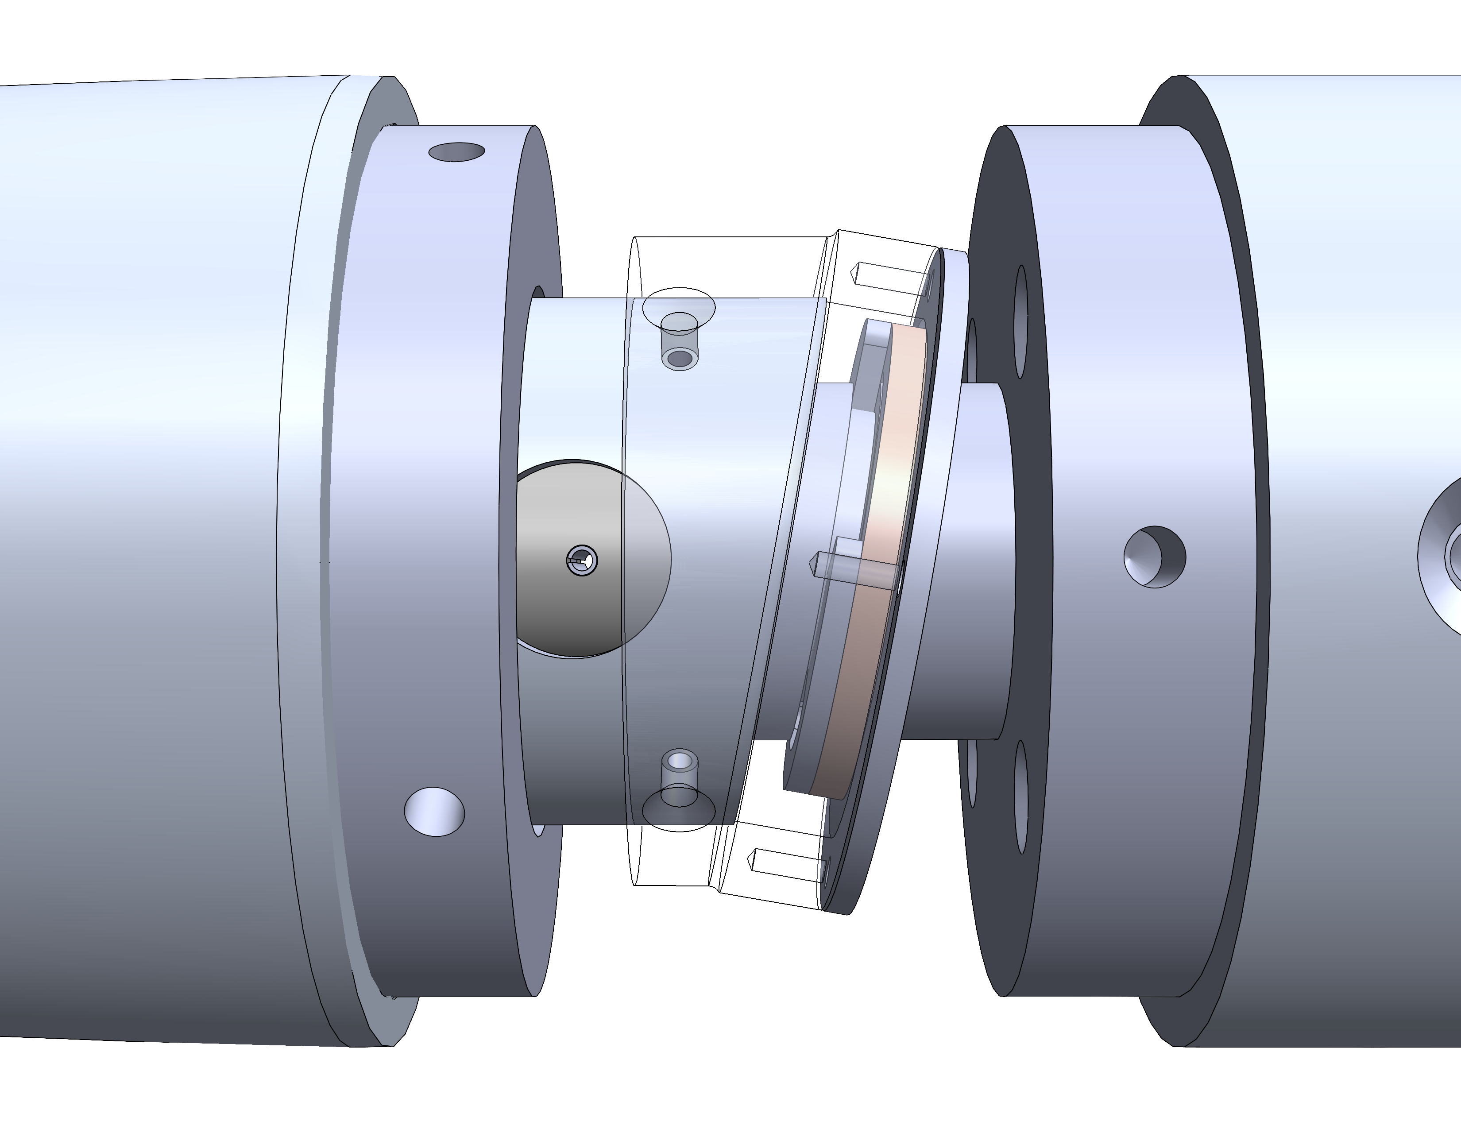
Combating Friction
Inherent friction between concentric surfaces
Solutions
  Washer and retaining clip
  Solid lubricants
  Bearings
Two face-mounted bearings used to rotate outer surfaces
Noah Moffeit

Slide 20
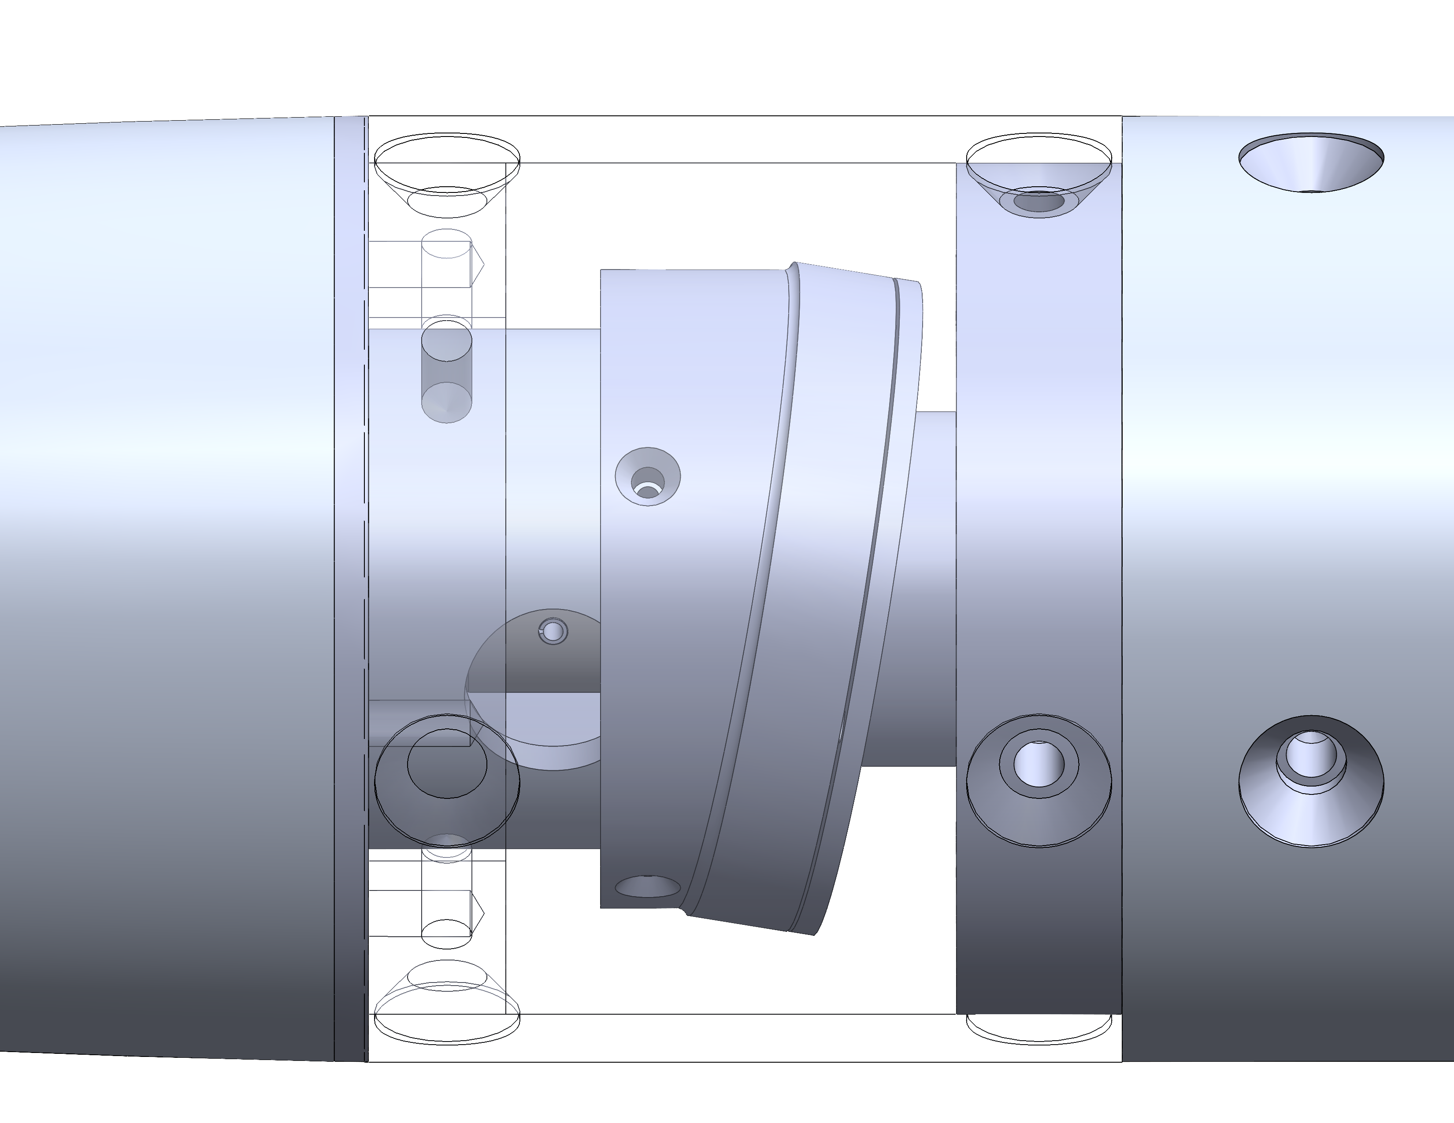
Gap Handling
Gap
Investigate flexible materials for the nose to body interface
Gap could possibly cause issues with stability of flow
Attempted Solutions:
  Silicon
  3-D Printed TPU Filament
  Multi-Filament 3-D print
Noah Moffeit

Slide 21
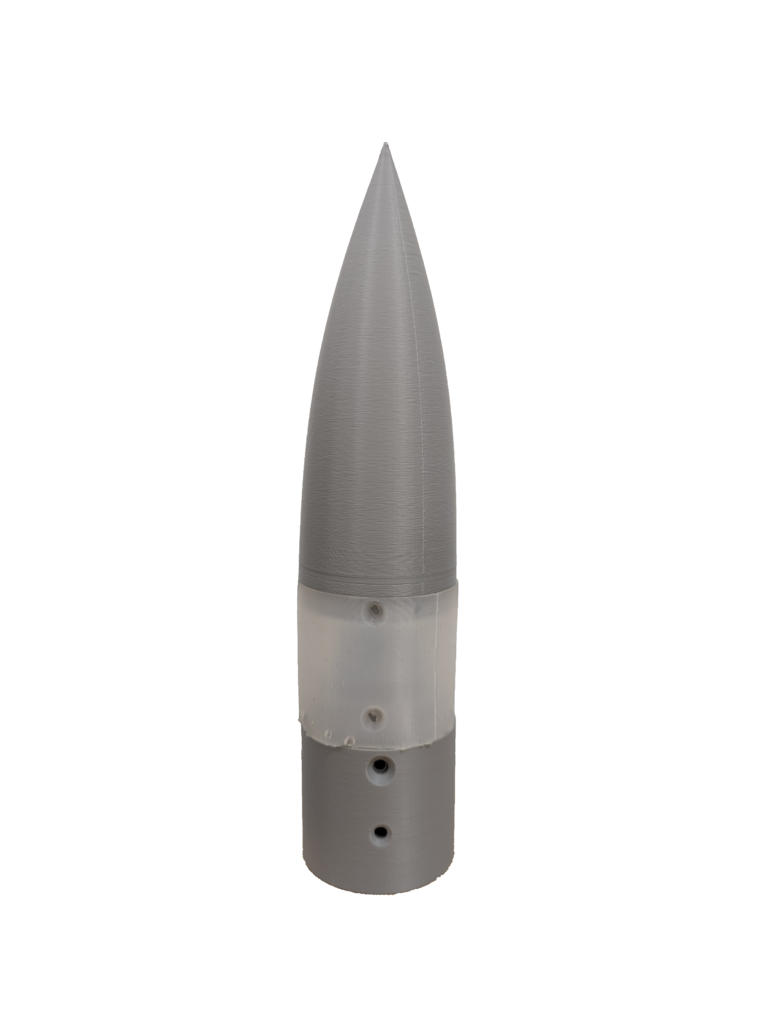
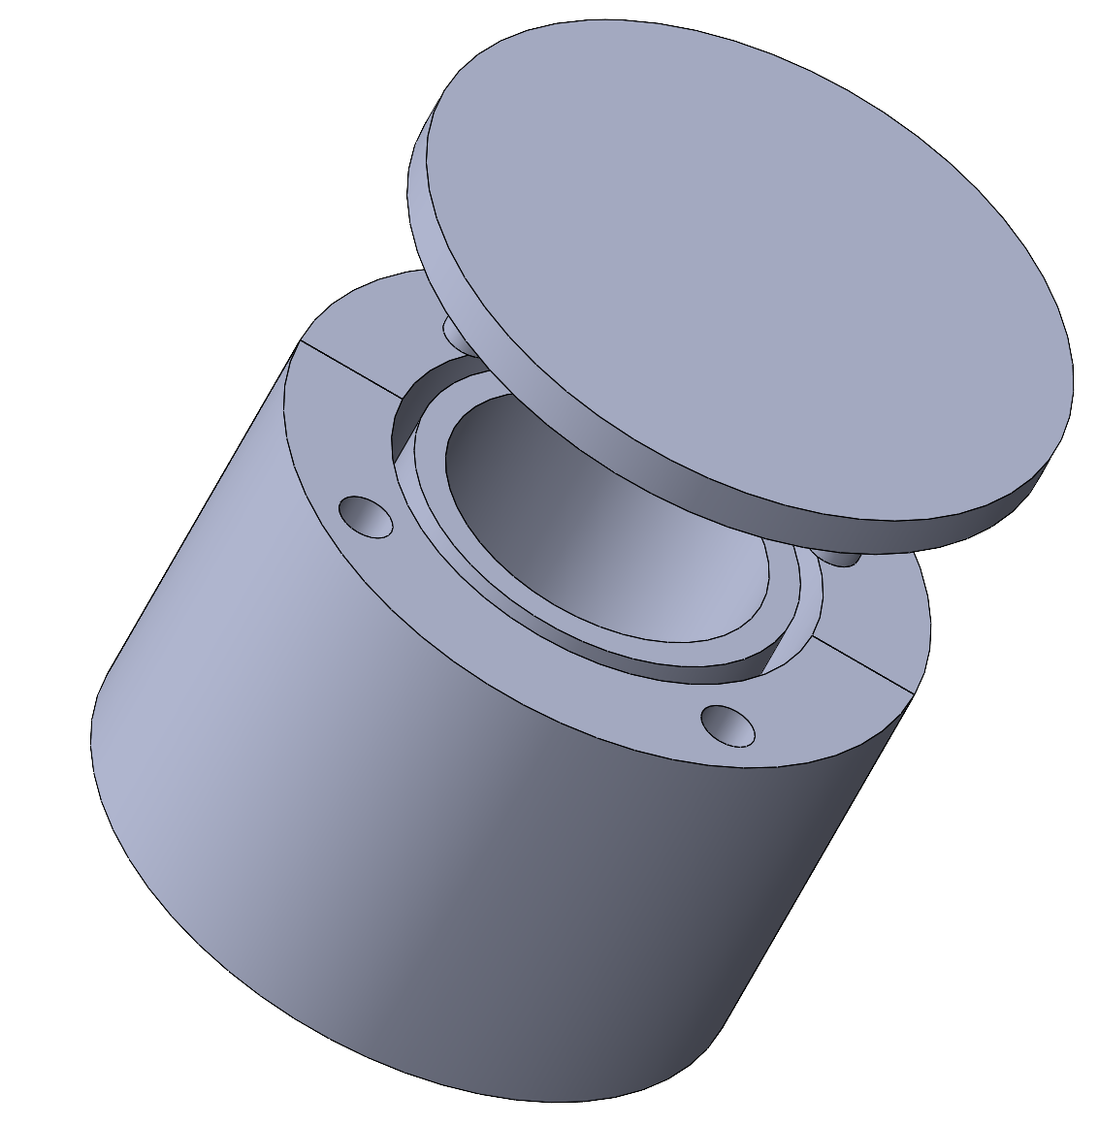
Gap Handling: Cast Resin
A silicon resin was cast in a 3D printed mold
  High flexibility that allows for bending
  Bubbles developed inside the resin creating possible stress concentrations
  Pinching occurs at moderate to high deflection
Noah Moffeit

Slide 22
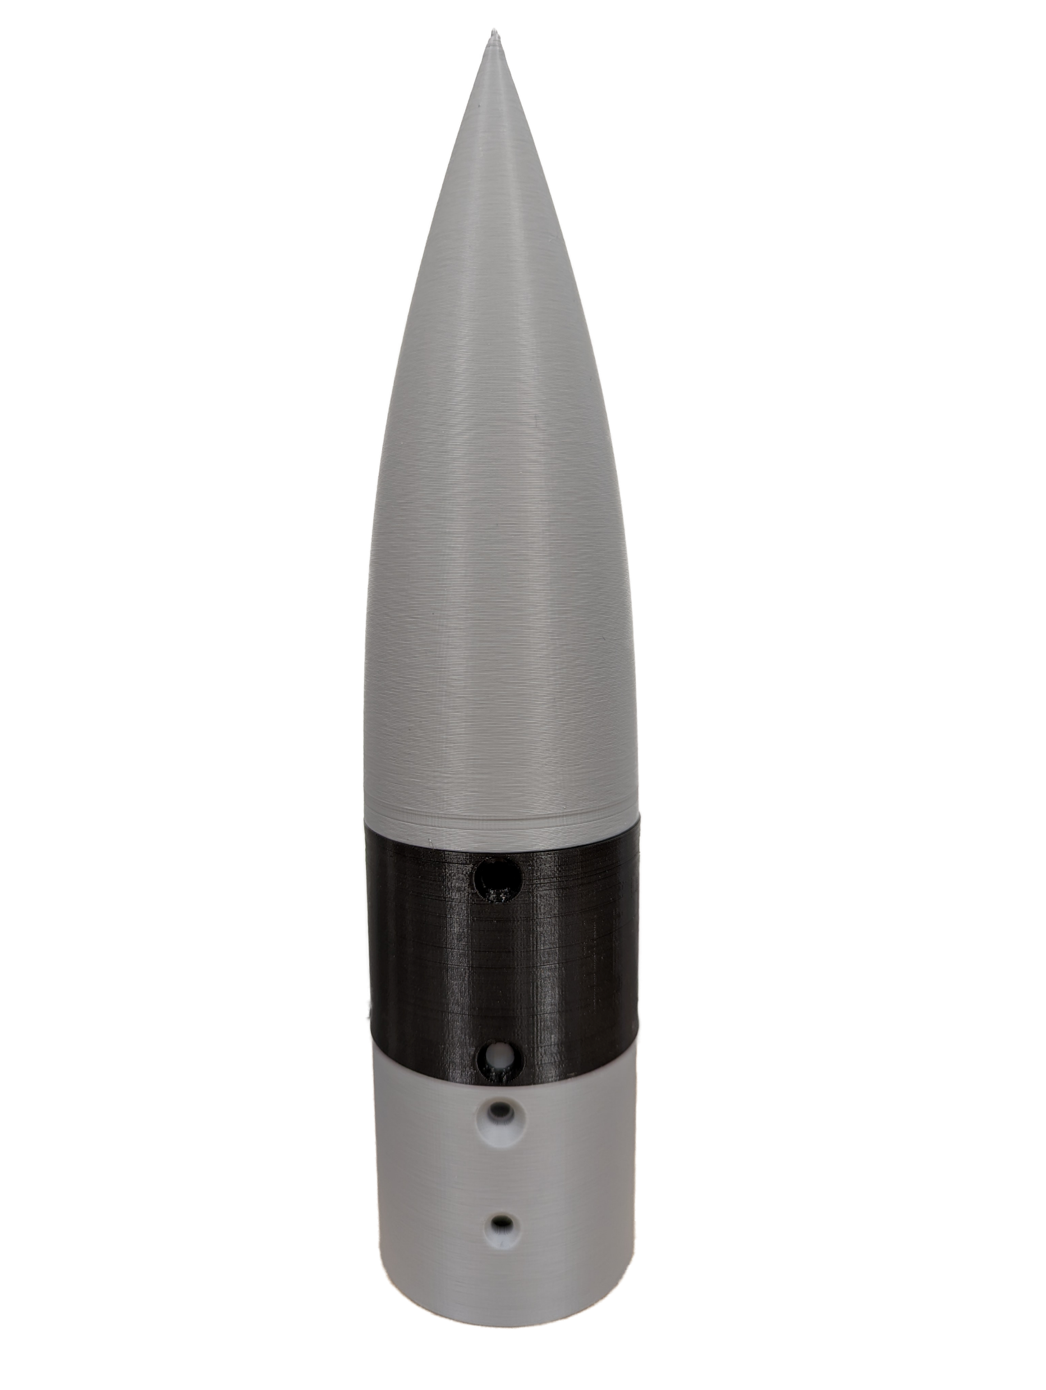
Gap Handling: 3D Printed Flex
NinjaFlex 3D Printer Filament
  Promising flex characteristics
  Will have to test multiple thicknesses
  Requires calibration and time to print
Noah Moffeit

Slide 23
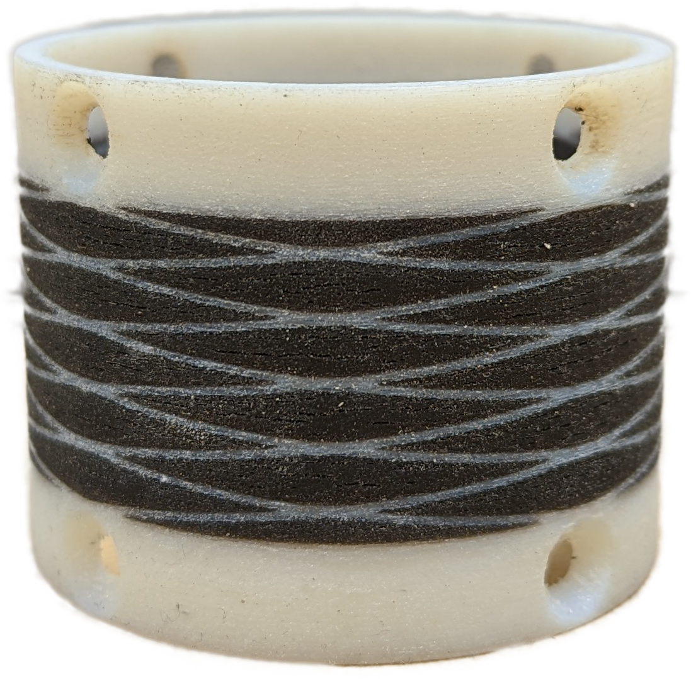
Gap Handling: Spring Sleeve
A mixed material 3d print has been designed to allow for spring-like flexibility while retaining rigidity
  Multiple sleeves in production by the Air Force Research Laboratory
  Restricted by the deflection angle
Noah Moffeit

Slide 24

Benchtop Testing
Calibrate motor rotation
Develop code to control
Sync rotation with data acquisition
Robert Smith

Slide 25
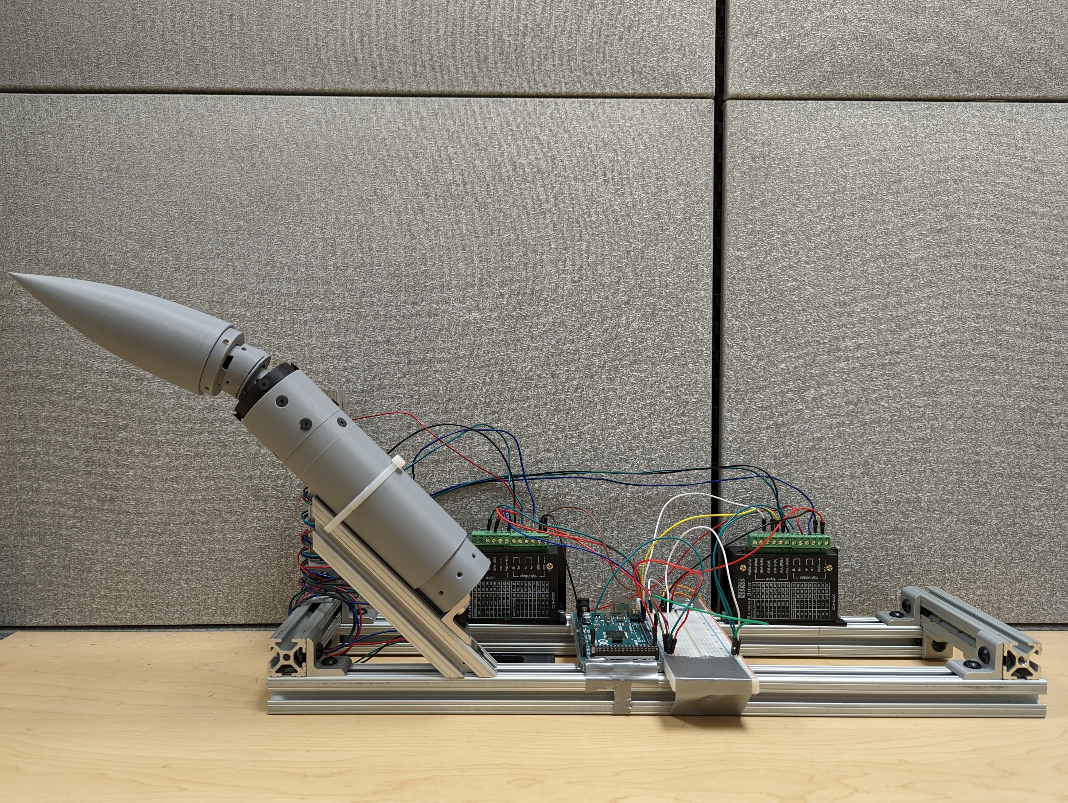
Experimental Setup
3D Printed Model
Microstepping Controllers
Arduino Mega
Robert Smith

Slide 26
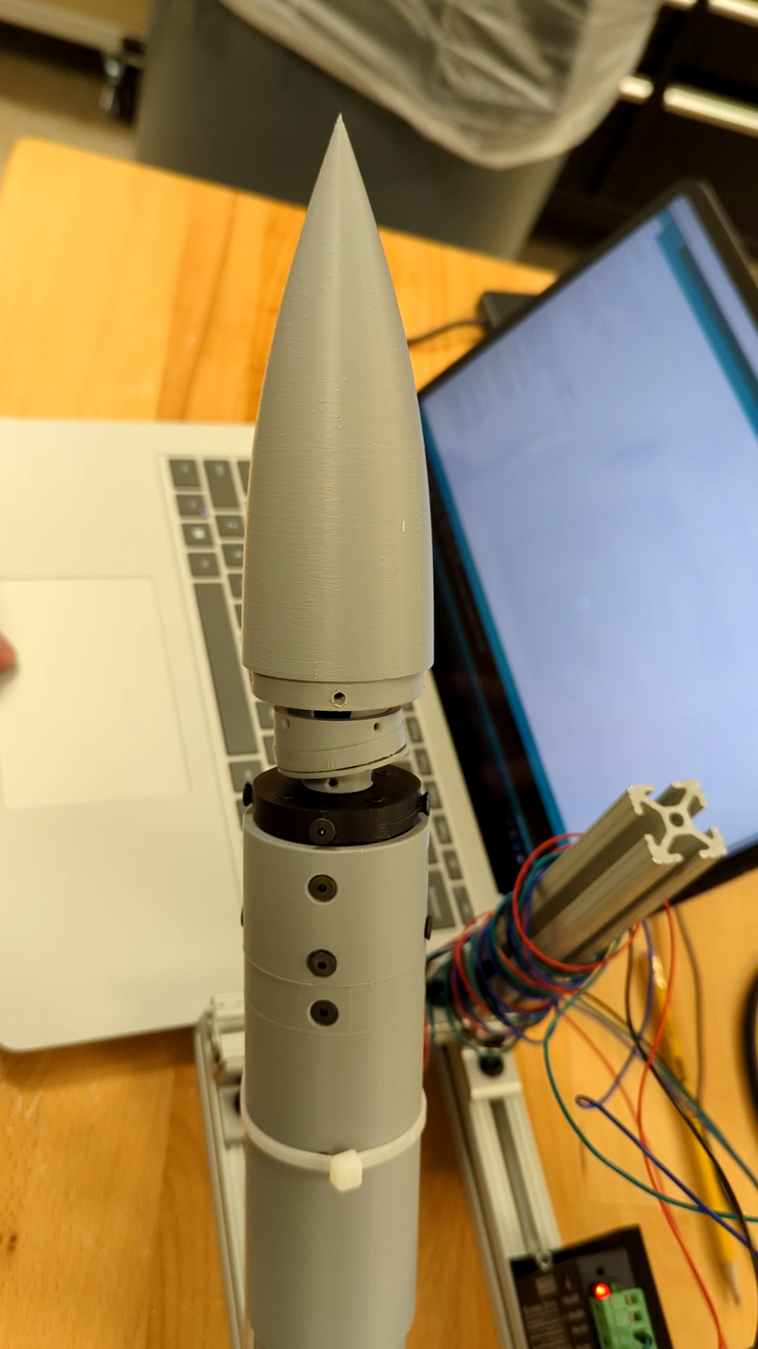
Demonstration
Video shows nose pitching to 20° of deflection
Controlled with Arduino script to quickly test motor capabilities
Microstepping was used to obtain for motor rotation steps of 0.45°
Robert Smith

Slide 27
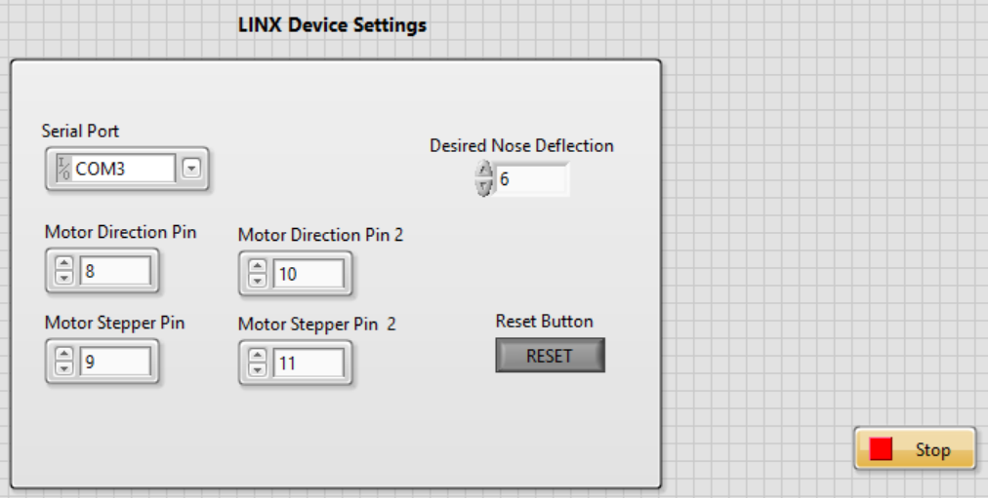
LabVIEW Setup
Allows for definition of connections pins and ports
User enters desired Nose Deflection Angle
Reset button adjust the nose back to the starting orientation
Robert Smith

Slide 28
Incomplete Work
LabVIEW setup with easy interface
Producing a linear motion path for the nose to travel
Testing the model in the wind tunnel
Analyzing impact of the deflected nose cone
Robert Smith

Slide 29
Lessons Learned
Get feedback from your sponsor any time you are unsure about your project
Prototype early to root out key design problems
Consistently check with the machinist to determine part machinability
Realizing that admitting your original choices were wrong is the fastest way to progress
Robert Smith

Slide 30
Summary
Objective
Create a mechanism that would allow for the articulation of a missile model’s nose cone
Design
We chose the concentric surface design after determining it was best suited to fulfill our needs
Incomplete Work
We were not able to test our model in the wind tunnel and obtain data
Targets
The goals for the project were to deflect a nose cone 20° with any combination of pitch or yaw
Outcome
The nose cone was successfully able to rotate to 20° and roll
Robert Smith

Slide 31
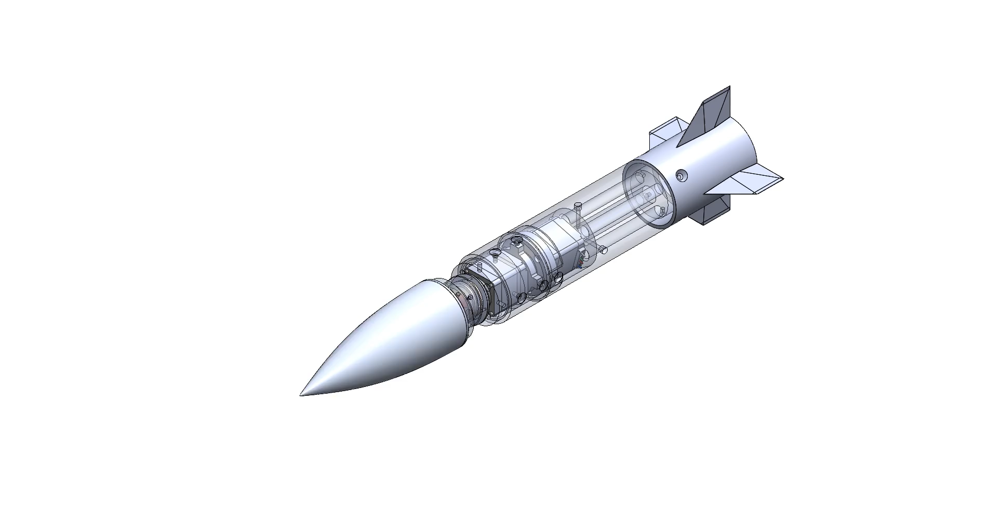
Thanks for listening
`
Jed Fazler
Robert Smith
Noah Moffeit
Nicholas
Samuda
Jed Fazler | Noah Moffeit | Nicholas Samuda | Robert Smith

Slide 32
Project Description and Key Goals
This project aims to create a technology that can be applied to many projectile configurations, allowing the projectile to maneuver adaptively through unforeseen, hazardous environments. The technology developed will detect said obstacles or conditions and actuate the projectile autonomously.
The key goals were selected to itemize the main objectives that must be accomplished over the duration of the project based on the project’s description and advice from the project’s sponsor. The following are the goals or milestones we have derived to ensure the project’s completion:
  Conceptualize and research 5 different innovative ways to maneuver a projectile.
  Choose one of these designs to expand upon and develop into a working design.
  Develop innovative technologies that can be implemented into the projectile allowing for smart capabilities.
  Develop a way for the projectile to adapt to its environment or obstacles through autonomous actions.
  Construct a scaled down model of the projectile for use in wind tunnel testing to verify desired aerodynamic characteristics of design.
  Construct a prototype projectile to test actuation of the smart functionality within the projectile.

Slide 33
Market
The primary market for this project was seen as the company or organization that the product would be directly constructed for and would use the product.
Primary Markets:
  Florida Center for Advanced Aero Propulsion (FCAAP)
The secondary markets are a makeup of other companies or organizations who may benefit from or would be interested in purchasing the results of this project.
Secondary Markets:
  Air Force Office of Scientific Research (AFOSR)
  Lockheed Martin
  Raytheon Technologies
  Northrop Grumman

Slide 34




Assumptions
Propulsion
It is assumed that:
Projectile deployment
Entailing storage
Transportation
Initial launch
will be facilitated by technologies already implemented in the projectile. It is also assumed that the projectile will remain within earth’s atmospheric conditions for its use.
Deployment
Storage

Slide 35
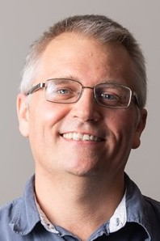
Stakeholders
The stakeholders for this project include all parties who will have influenced the design of the technologies produced by the project as well as those who have invested time and other resources into the project.
Dr. Shayne McConomy
Dr. Rajan Kumar
Dr. Jonas Gustavsson
FCAAP
FAMU-FSU College of Engineering

Slide 36
Customer Needs
How do you think current control surfaces and their actuation can be improved? | Current control surfaces require clean flow, which is not realistic at high angles of attack, so that’s something. | Projectile accommodates for attached flow over control surfaces.
What draw backs come with standard fin deflections as a control surface? | Must have clean flow to actuate properly. Size and weight that come with actuation mechanism | Projectile control surfaces will be suitable effective even in detached flow.
What Mach numbers would be expected for this projectile? | FCAAP polysonic wind tunnel can’t go faster than Mach 5. We’ll probably test Mach 4. | The projectile can withstand Mach 4.
What slenderness ratio of the projectile would be appropriate? | Would be nice if it could be tied into what we have done already. Matching a baseline design here at FCAAP. 8-10 | The projectile uses a basic axisymmetric body configuration based on previously tested models.

Slide 37
Customer Needs
Do we need to worry about designing the method of propulsion? | Don’t worry about designing the propulsion as we cannot have it modeled in the wind tunnel. | Propulsion is beyond the scope of this project.
By the end of this project, what level of manufacturing should be accomplished to demonstrate our results? | Small model for testing control surfaces in wind tunnel, larger model for demonstration purposes and sensing capabilities. Radar sensors possible option. | The projectile is modelled for aerodynamic testing and then prototyped for proof of actuation.
What conditions do you expect the projectile to operate in? | Projectile should go where the target goes. High angles of attack. Initial deployment shockwaves and vortices. Vibrations in supersonic can affect and disrupt the electronics. | The projectile has a way to rapidly adapt to the conditions that exist during deployment.
Should the projectile be able to actuate without user input? | Yes | The projectile is automatically operated.

Slide 38
Customer Needs
Should favorable aerodynamic characteristics be prioritized over functionality? | No, it should accomplish the task while minimizing negative effects. Compare to previous results. | Maintaining aerodynamic characteristics is secondary to maintaining control surface effectiveness.
What is considered a “harsh” or “hazardous” | Vortices, and shockwaves off the parent aircraft. High angles of attack | The missile adapts to high pitch angles.
What will be the preferred method of flow visualization? | It looks good. Better for showing actuation effects. Could be done with shadow graph in the wind tunnel. Not necessary but helpful. | Flow visualization will be done through other tests such as shadowgraph or oil flow.
Will the projectile also have to accommodate targeting? | Does not necessarily need to sense targets, could also sense high angles of attack. | The missile can sense its angle of attack in various scenarios.

Slide 39
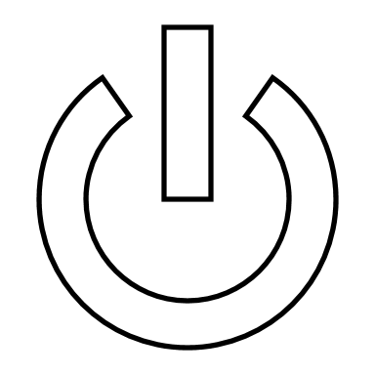

Functional Decomposition
Storage
Provides power for components
POWER
Transmission
Transfers power to components
Jed Fazler

Slide 40

Functional Decomposition
Sensors
Monitors sensor data
SENSING
Interprets sensor data
Signaling
Transmits response signal
Jed Fazler

Slide 41
Functional Decomposition
Flow
Maintains flow attachment
Controls pitch
ACTUATION
Mechanical
Controls roll
Controls yaw
Jed Fazler

Slide 42
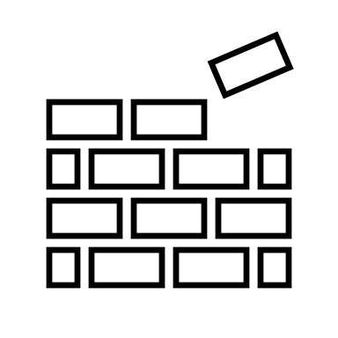
Functional Decomposition
Maintains integrity
STRUCTURE
Protects components
Jed Fazler

Slide 43
Jed Fazler
Noah Moffeit
Robert Smith
Nicholas
Samuda

Slide 44
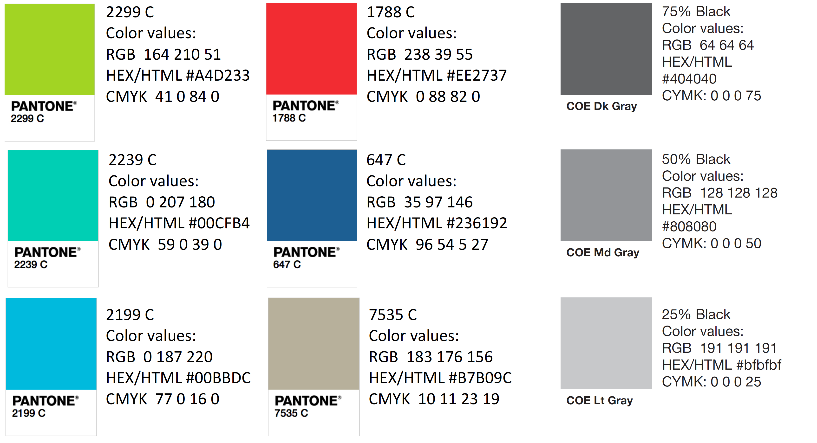
Color Palette
How do you think current control surfaces and their actuation can be improved? | Current control surfaces require clean flow, which is not realistic at high angles of attack, so that’s something. | Projectile accommodates for attached flow over control surfaces.
What draw backs come with standard fin deflections as a control surface? | Must have clean flow to actuate properly. Size and weight that come with actuation mechanism | Projectile control surfaces will be suitable effective even in detached flow.
What Mach numbers would be expected for this projectile? | FCAAP polysonic wind tunnel can’t go faster than Mach 5. We’ll probably test Mach 4. | The projectile can withstand Mach 4.
What slenderness ratio of the projectile would be appropriate? | Would be nice if it could be tied into what we have done already. Matching a baseline design here at FCAAP. 8-10 | The projectile uses a basic axisymmetric body configuration based on previously tested models.

Slide 45
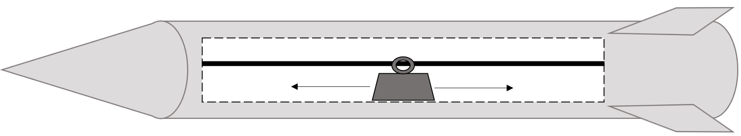
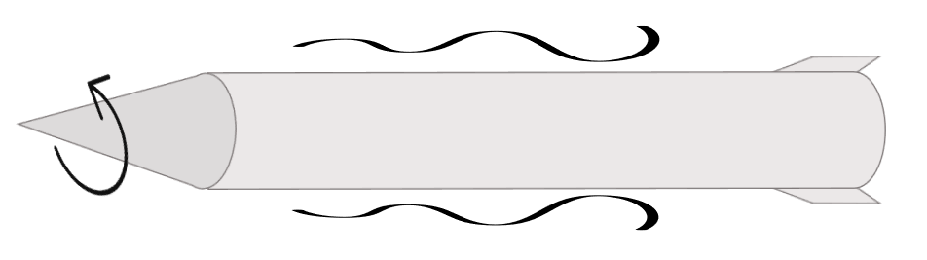
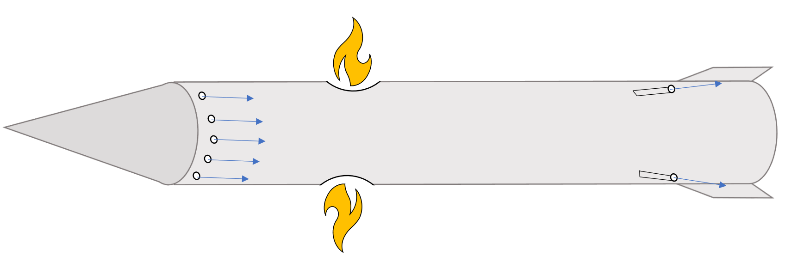
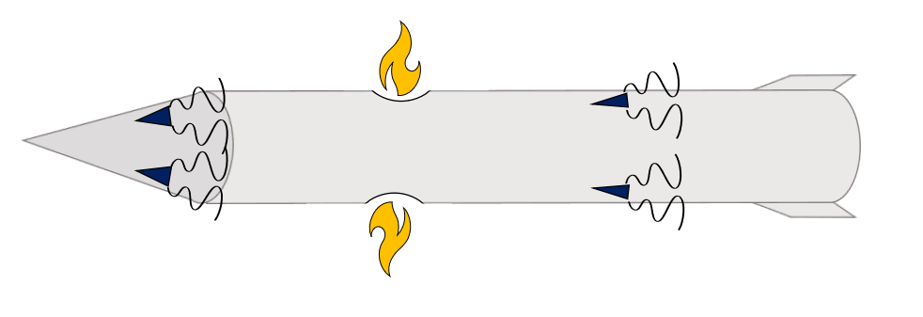
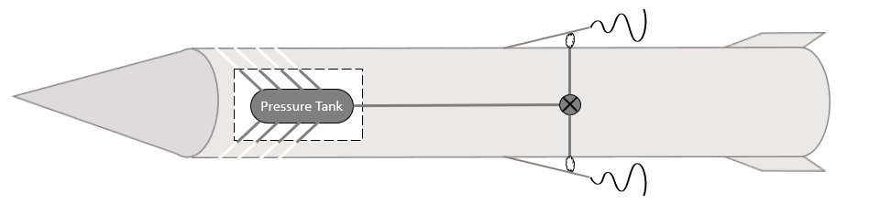

Slide 46
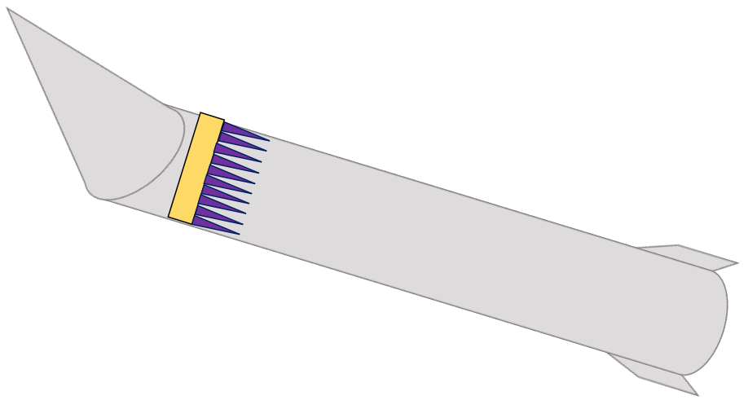
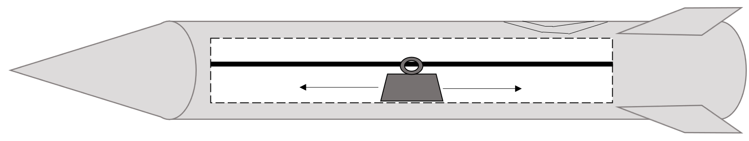
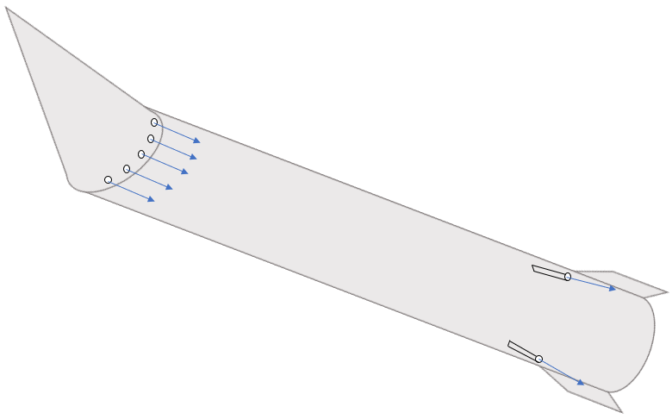

Slide 48
Polar Control Model
4
1
6
4
1
Pin Holders
Worm Gear
3
2
5
Spur Gear
Sliding Pin
3
Pin Slot Link
6
Motor Mount
5
2
7
7
Stepper Motor
Nicholas Samuda

Slide 50
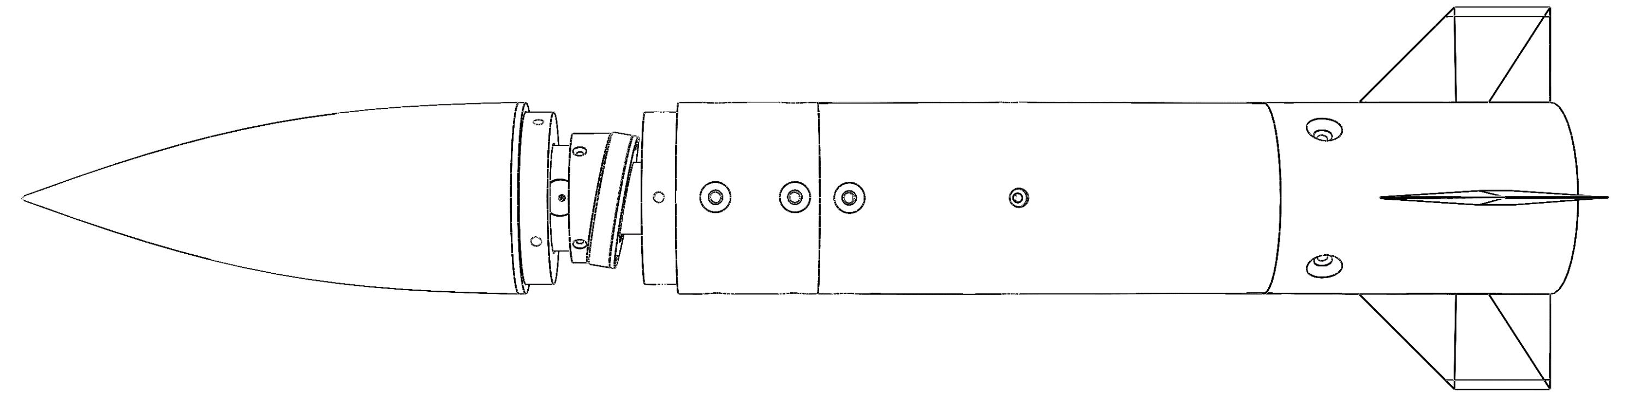

Slide 51
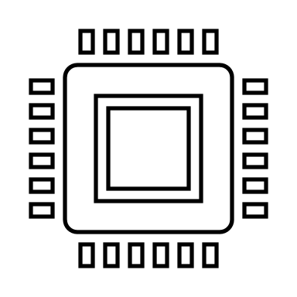
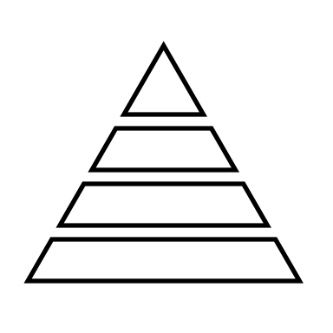
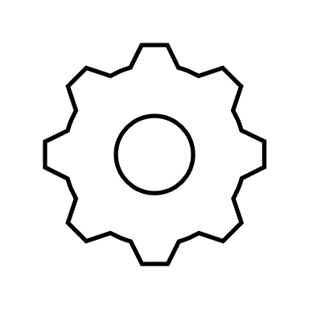

Slide 52
Nose Pulleys
Linear Actuators
Rotating Contact Surfaces
2 DOF Gear Box
Polar Controller
Basic Rotating Nose
Robert Smith

